Slide 1
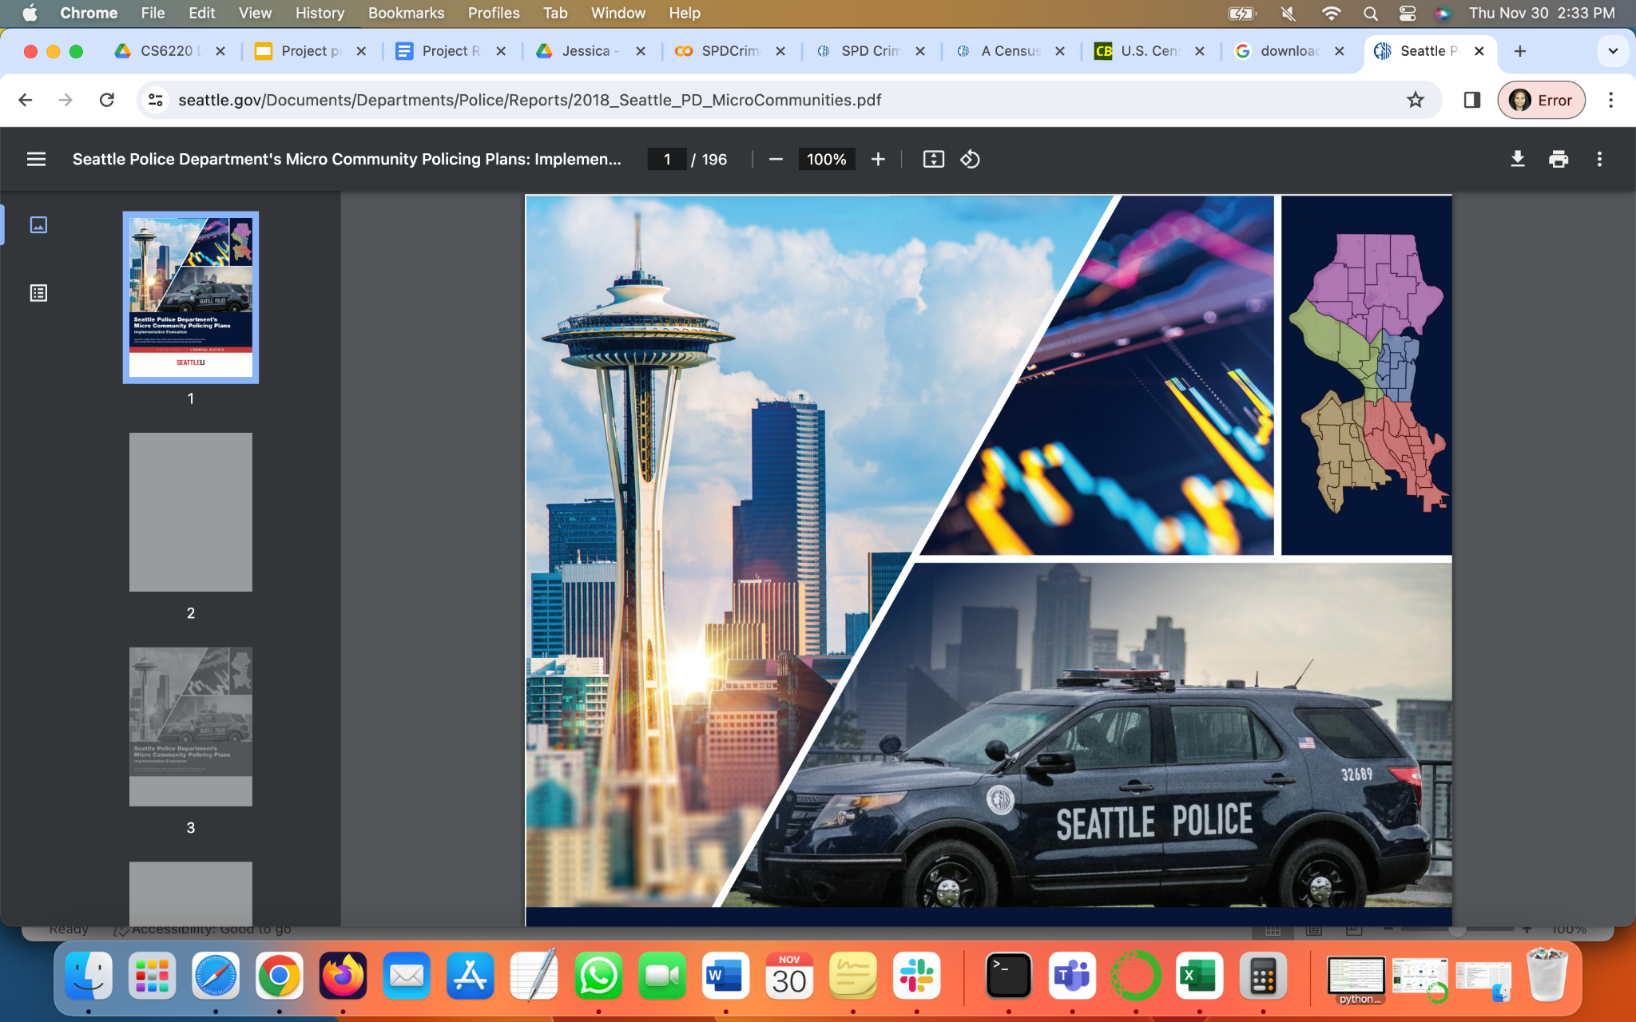
Seattle Crime Analysis
CS 6140 Fall 2023
Project Team 7:
Rohini Kolli Likitha Jagithyala

Slide 2

What is the Problem?
Increase in Crime with time
Urban areas with most crimes
Intimidating experience for new resident.
Lack of Informed Decision

Slide 3


Data Source
‘SPD Crime Data: 2008-Present | City of Seattle Open Data portal. (2023, October). https://data.seattle.gov/Public-Safety/SPD-Crime-Data-2008-Present/tazs-3rd5’.
‘A Census Tract (2010) Profile ACS 5-year Estimates 2006-10 | City of Seattle Open Data portal. (2023, June 24).
https://data.seattle.gov/dataset/A-Census-Tract-2010-Profile-ACS-5-year-Estimates-2/nqi3-zrh6’

Slide 4
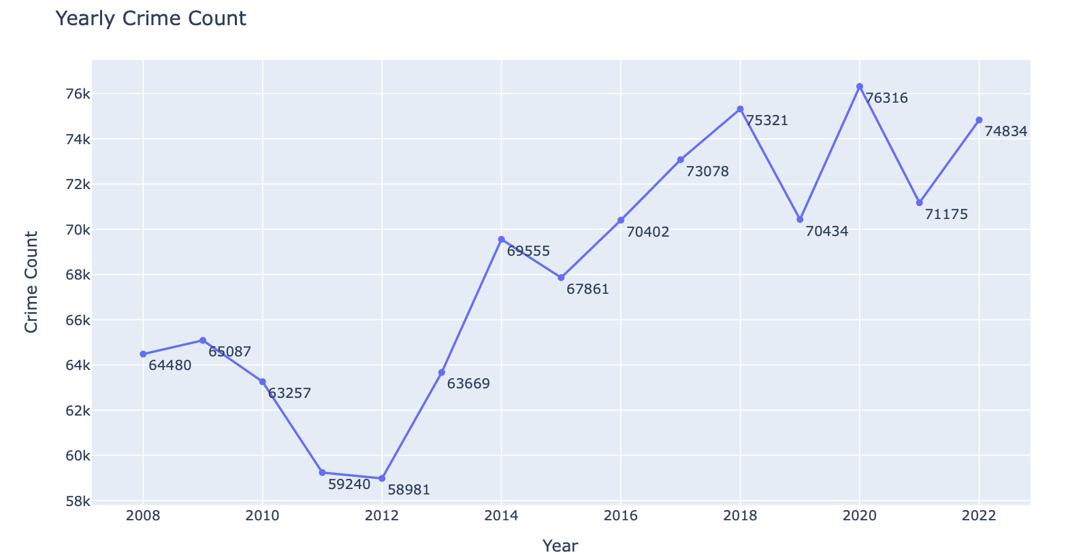
Exploratory Data Analysis
Notes:
fun and interesting data exploration findings

Slide 5
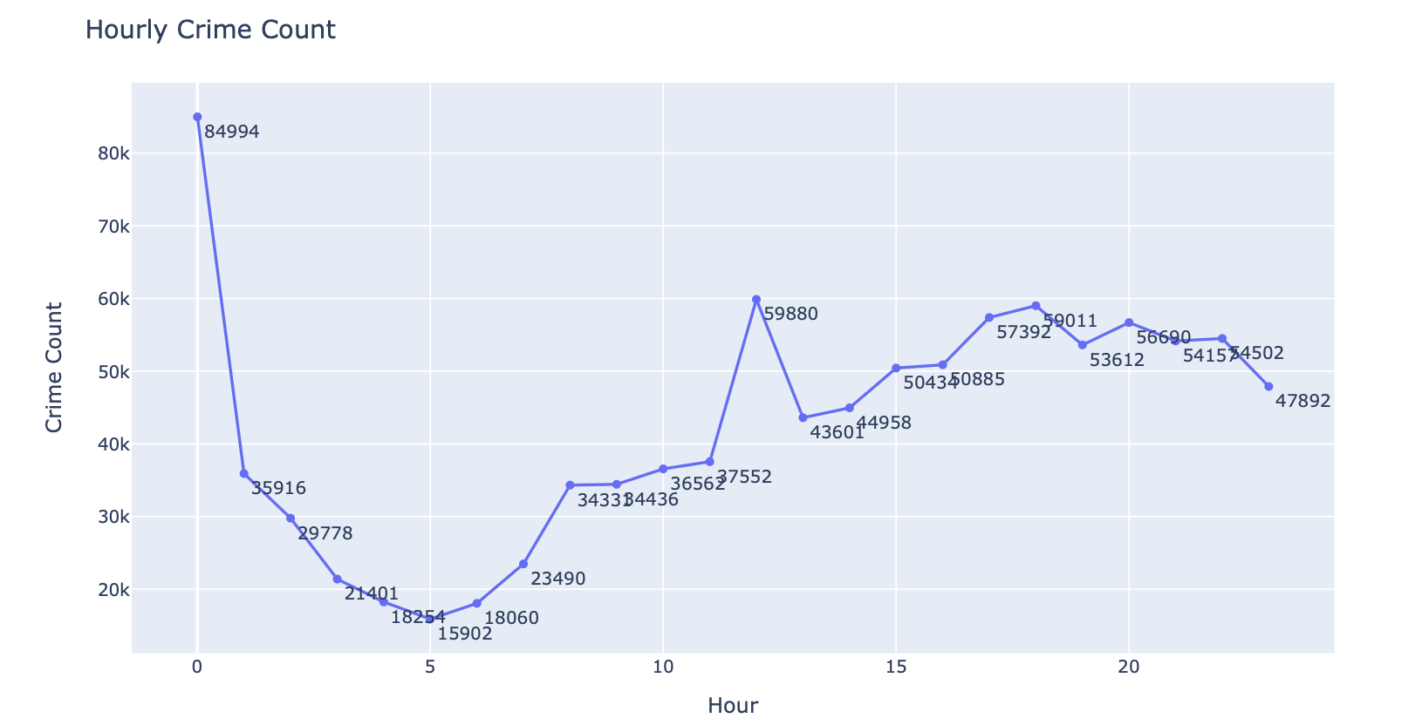

Slide 6
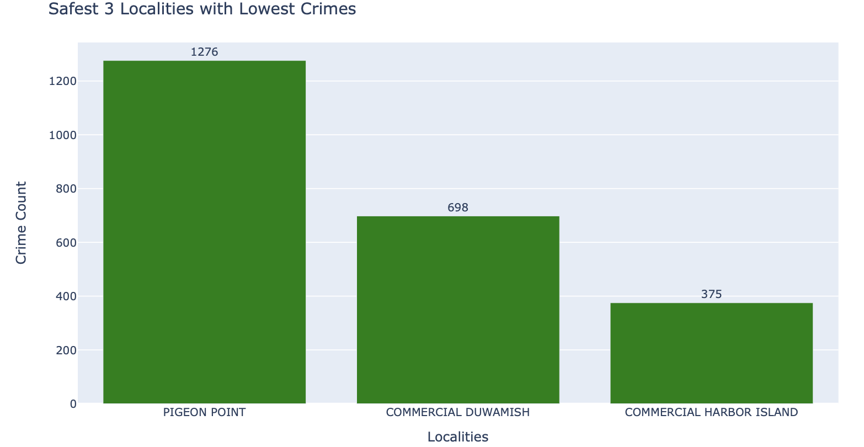
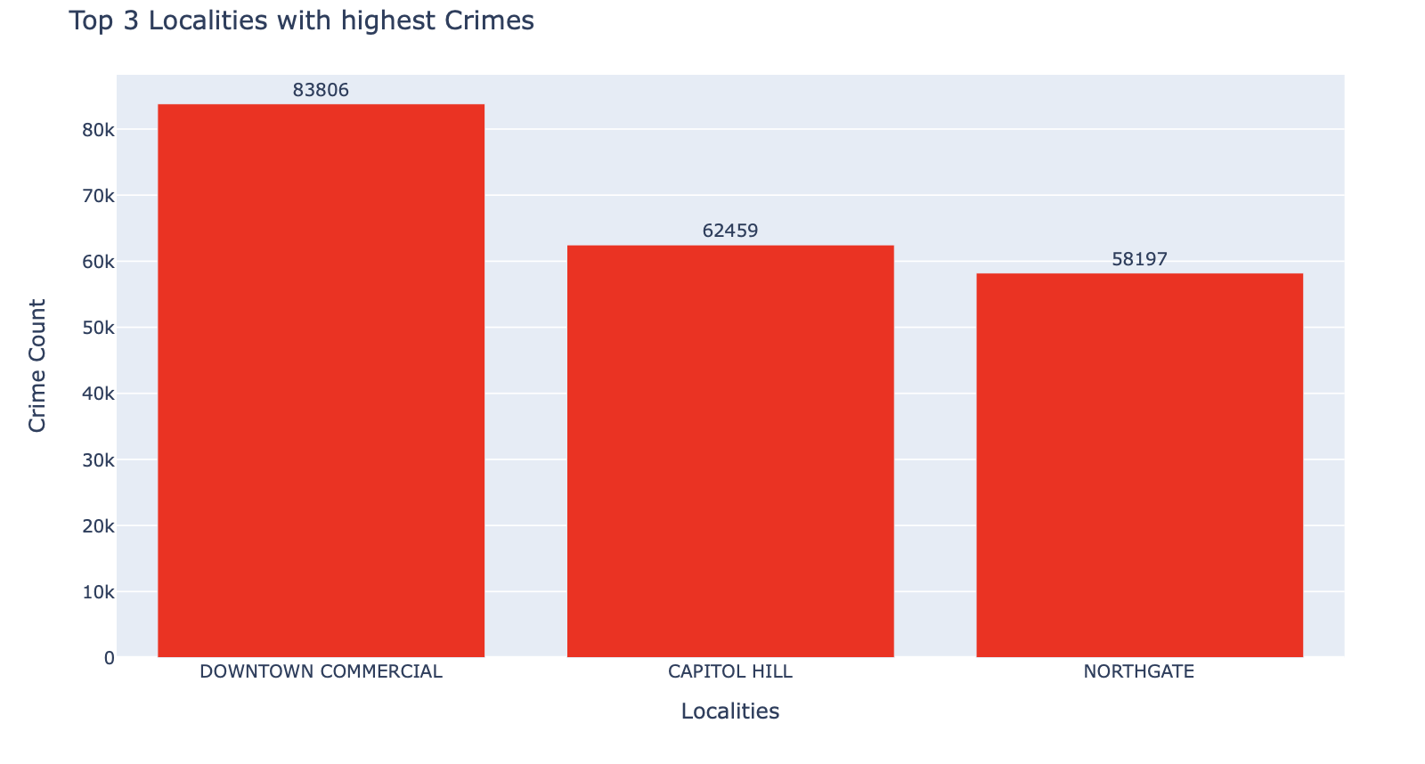

Slide 7
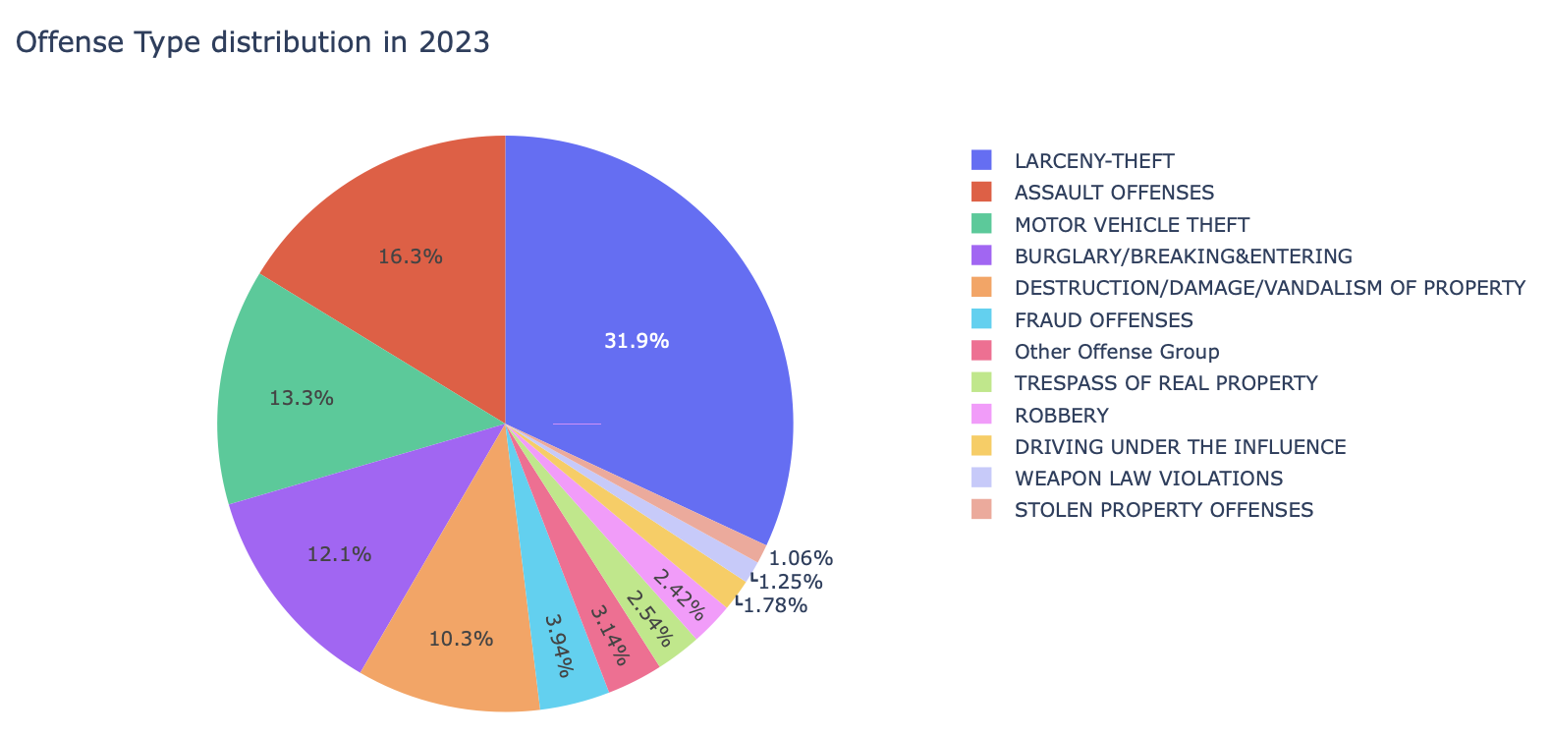
Pie Chart showing % of Offense Parent Group distribution for 2023

Slide 8
Crime Rate Predictive Analysis

Slide 9
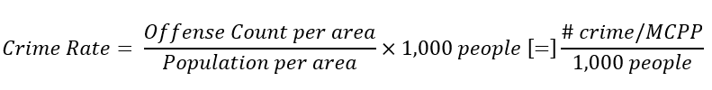
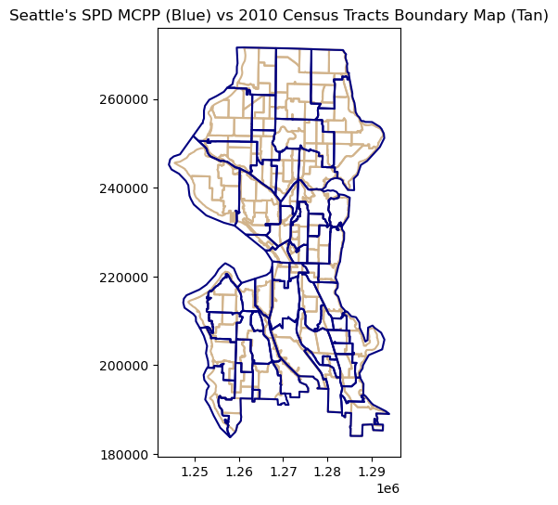
What is Crime Rate ?
Census data helps predicting crime rate per MCPP?
Population, land area (acres),
median age, % bachelor,
% of occupied housing, median gross rent,
% unemployment, median household income, % poverty
Challenge: boundary crossover!
gpd.sjoin() vs. gpd.overlay() & % area
https://data-seattlecitygis.opendata.arcgis.com/datasets/SeattleCityGIS::a-census-tract-2010-profile-acs-5-year-estimates-2006-2010-1/explore?showTable=true
Notes:
Need to do the opposite of PCA/ feature engineering by adding external dataset (Feature engineering)
CR definition: "first divide the population of the area by 1,000, then divide the crime category or grouping by that answer". # of offense per season per MCPP per 1,000 people
WARNING: this is an estimation, need further analysis to increase accuracy
ACS2010 population statistics estimate for KC: 137 Population Statistics features, clip to only Seattle.
Problematic spatial join because of different boundaries. Cannot use regular gpd.sjoin()

Slide 10
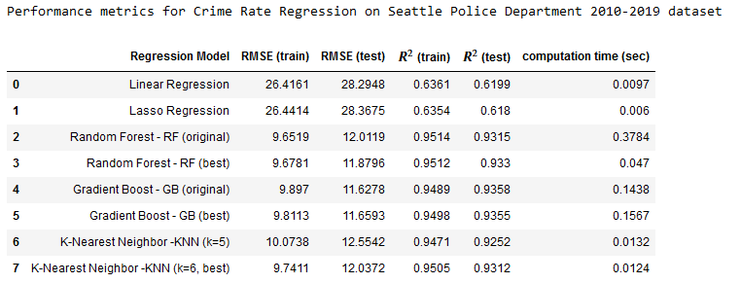

Slide 11
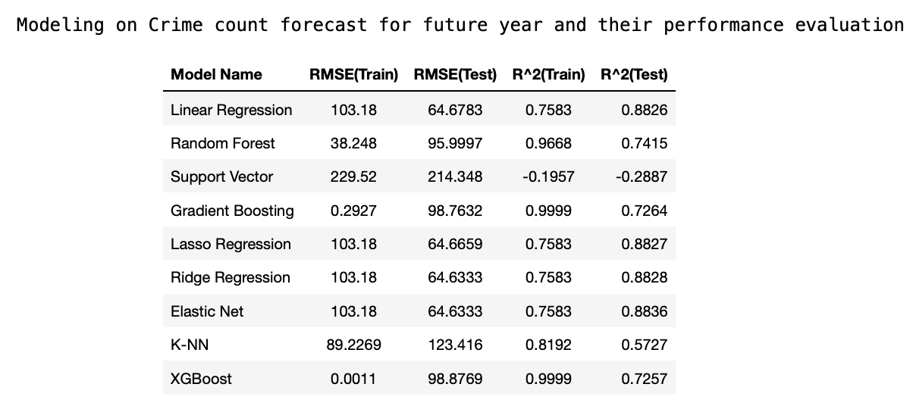
Time Series Forecast/ Predictive Analysis
Forecast /predict crime count for future years based on historical data

Slide 12
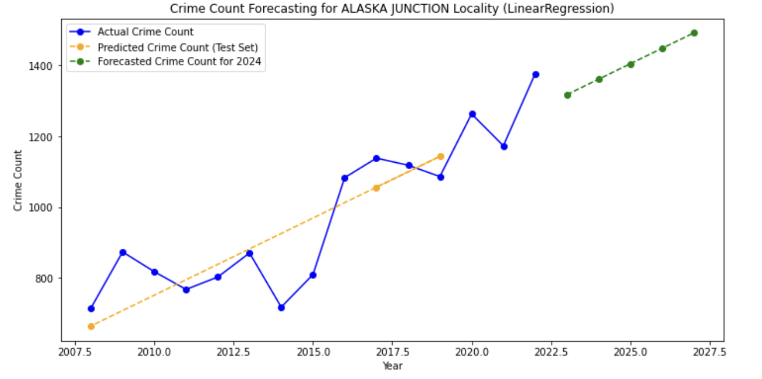

Slide 13
Predicting Likelihood of Top Crime Types in MCPP Zones
Objective: To predict the likelihood of top crime types within Major Crime Prevention Program (MCPP) zones.
Models used : Logistic Regression, Random forest , Decision tree , Gradient boosting .
Metrics used to evaluate: Precision, Recall, F-1 score.

Slide 14
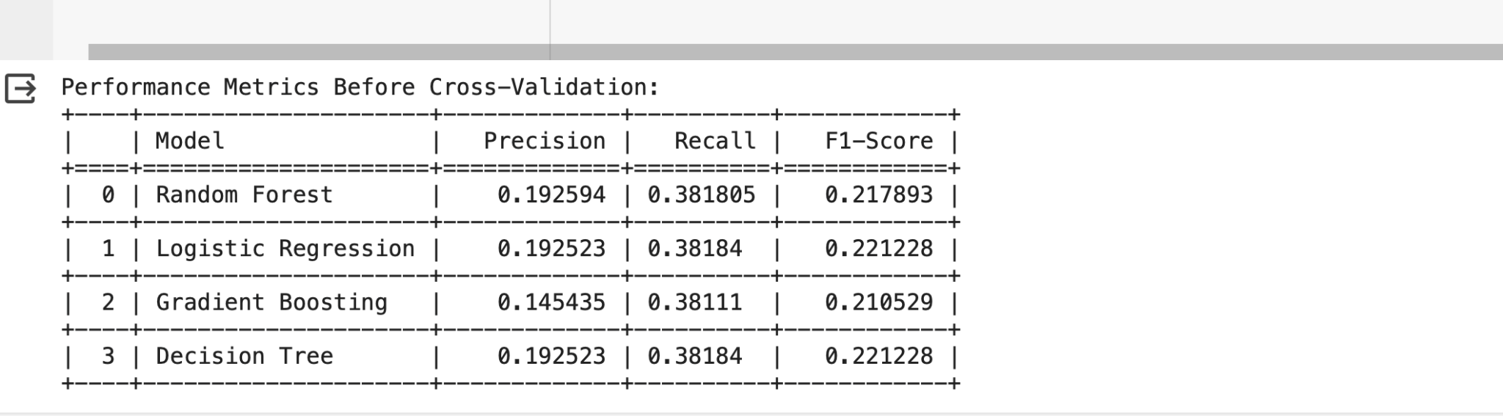
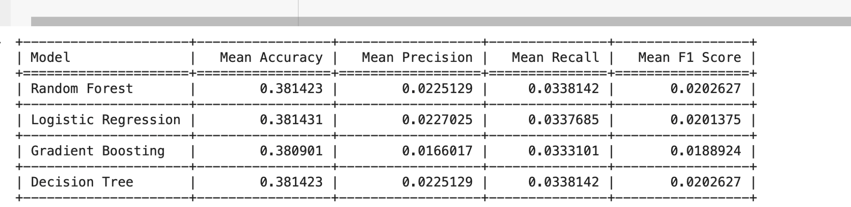
Evaluation before and after cross validation

Slide 15
CONCLUSION AND FUTURE WORK
Crime rate Analysis required extensive data cleaning and feature engineering.
Time series forecast can be further explored by introducing short interval forecast to enhance the data pattern
Explore Transformers and Neural network
Moving forward, we aim to enhance our models through advanced feature engineering, hyperparameter optimization, and potentially incorporating more complex algorithms. Additionally, integrating more contextual data, like socio-economic indicators, could enrich our models' understanding of the underlying patterns in crime data.

Slide 16
Thank you!

